Slide 1
Tax Information for US Resident Students and Scholars
Nabih Daaboul
Carol McNeil
Rich Wagman
PricewaterhouseCoopers LLP

Slide 2
Fellowship Stipends (Not Earned Income)
Regarding Students:
Fellowship stipends received by a degree candidate and used for qualified expenses are generally excluded from income
Qualified expenses include tuition and enrollment fees, books, supplies and equipment (must be required for all students) that are required for your course work
Qualified expenses do not include room and board and other expenses such as travel
You are responsible to report as taxable income (federal and state) the amount of a fellowship not used for qualifying expenses
MIT will not provide any income or stipend summary (W-2 or 1042-S) unless your tax treaty applies
Consider estimated tax payments (paying tax quarterly in April, June, September and January)

Slide 3
Fellowship Stipends (Not Earned Income)
Regarding Postdoctoral Fellows:
Fellowship stipends disbursed by MIT are subject to federal and state income taxes but not to Social Security or Medicare taxes
MIT is not permitted to withhold income tax on stipend payments
MIT will not provide any tax form
You are responsible to report as taxable income (federal and state) the amount of a fellowship not used for qualified expenses
Consider estimated tax payments (paying tax quarterly in April, June, September and January)

Slide 4
Taxable Stipends
Payment for services – TA and RA Assistantships and postdoctoral training
Payments received for past, present or future services such as teaching, research or other services will generally be taxable
For TA and RA, MIT will issue a Form W-2 and withhold based on the Form W-4 on file (federal and state)
For postdoc fellowships, MIT will not issue any tax form
Residents for tax purposes must pay tax on worldwide income (including foreign source fellowships)

Slide 5
Tax Reporting
If the only fellowships received are nontaxable because they are for tuition, books, etc., no tax form must be filed
If all or part of the funds received are taxable (RA, TA, postdoc fellowship), report the taxable amount as follows:
Form 1040
Report the taxable amount on line 7
If amount not reported on a Form W-2, enter “SCH” and the taxable amount on the dotted line next to line 7
If paid as an independent contractor, report amounts on Schedule SE (Self-Employment) of Form 1040 and pay SE tax if net earnings are $400 or more

Slide 6
Lifetime Learning Credit
A nonrefundable tax credit of 20% of up to $10,000 of qualified tuition and fees – credit cannot exceed $2,000 per return
Only credit for graduate students
AGI phase outs for 2014
$128,000 married filing joint
$64,000 single
Must be for qualified expenses
Must reduce for tax free parts of fellowships

Slide 7
Student Loans – Interest Deduction
Taxpayers are allowed to deduct up to $2,500 per year of interest paid on qualified education loans
Loan must have been taken out solely to pay qualified education expenses
Cannot be from a related person
Ability to deduct phases out between $65,000 and $80,000 of AGI ($130,000 and $160,000 married filing joint)

Slide 8
Filing Options
Software such as Turbotax (free online version for basic returns)
http://www.irs.gov/uac/Free-File:-Do-Your-Federal-Taxes-for-Free
IRS Volunteer Income Tax Assistance (“VITA”) program
http://www.irs.gov/Individuals/Free-Tax-Return-Preparation-for-You-by-Volunteers

Slide 9
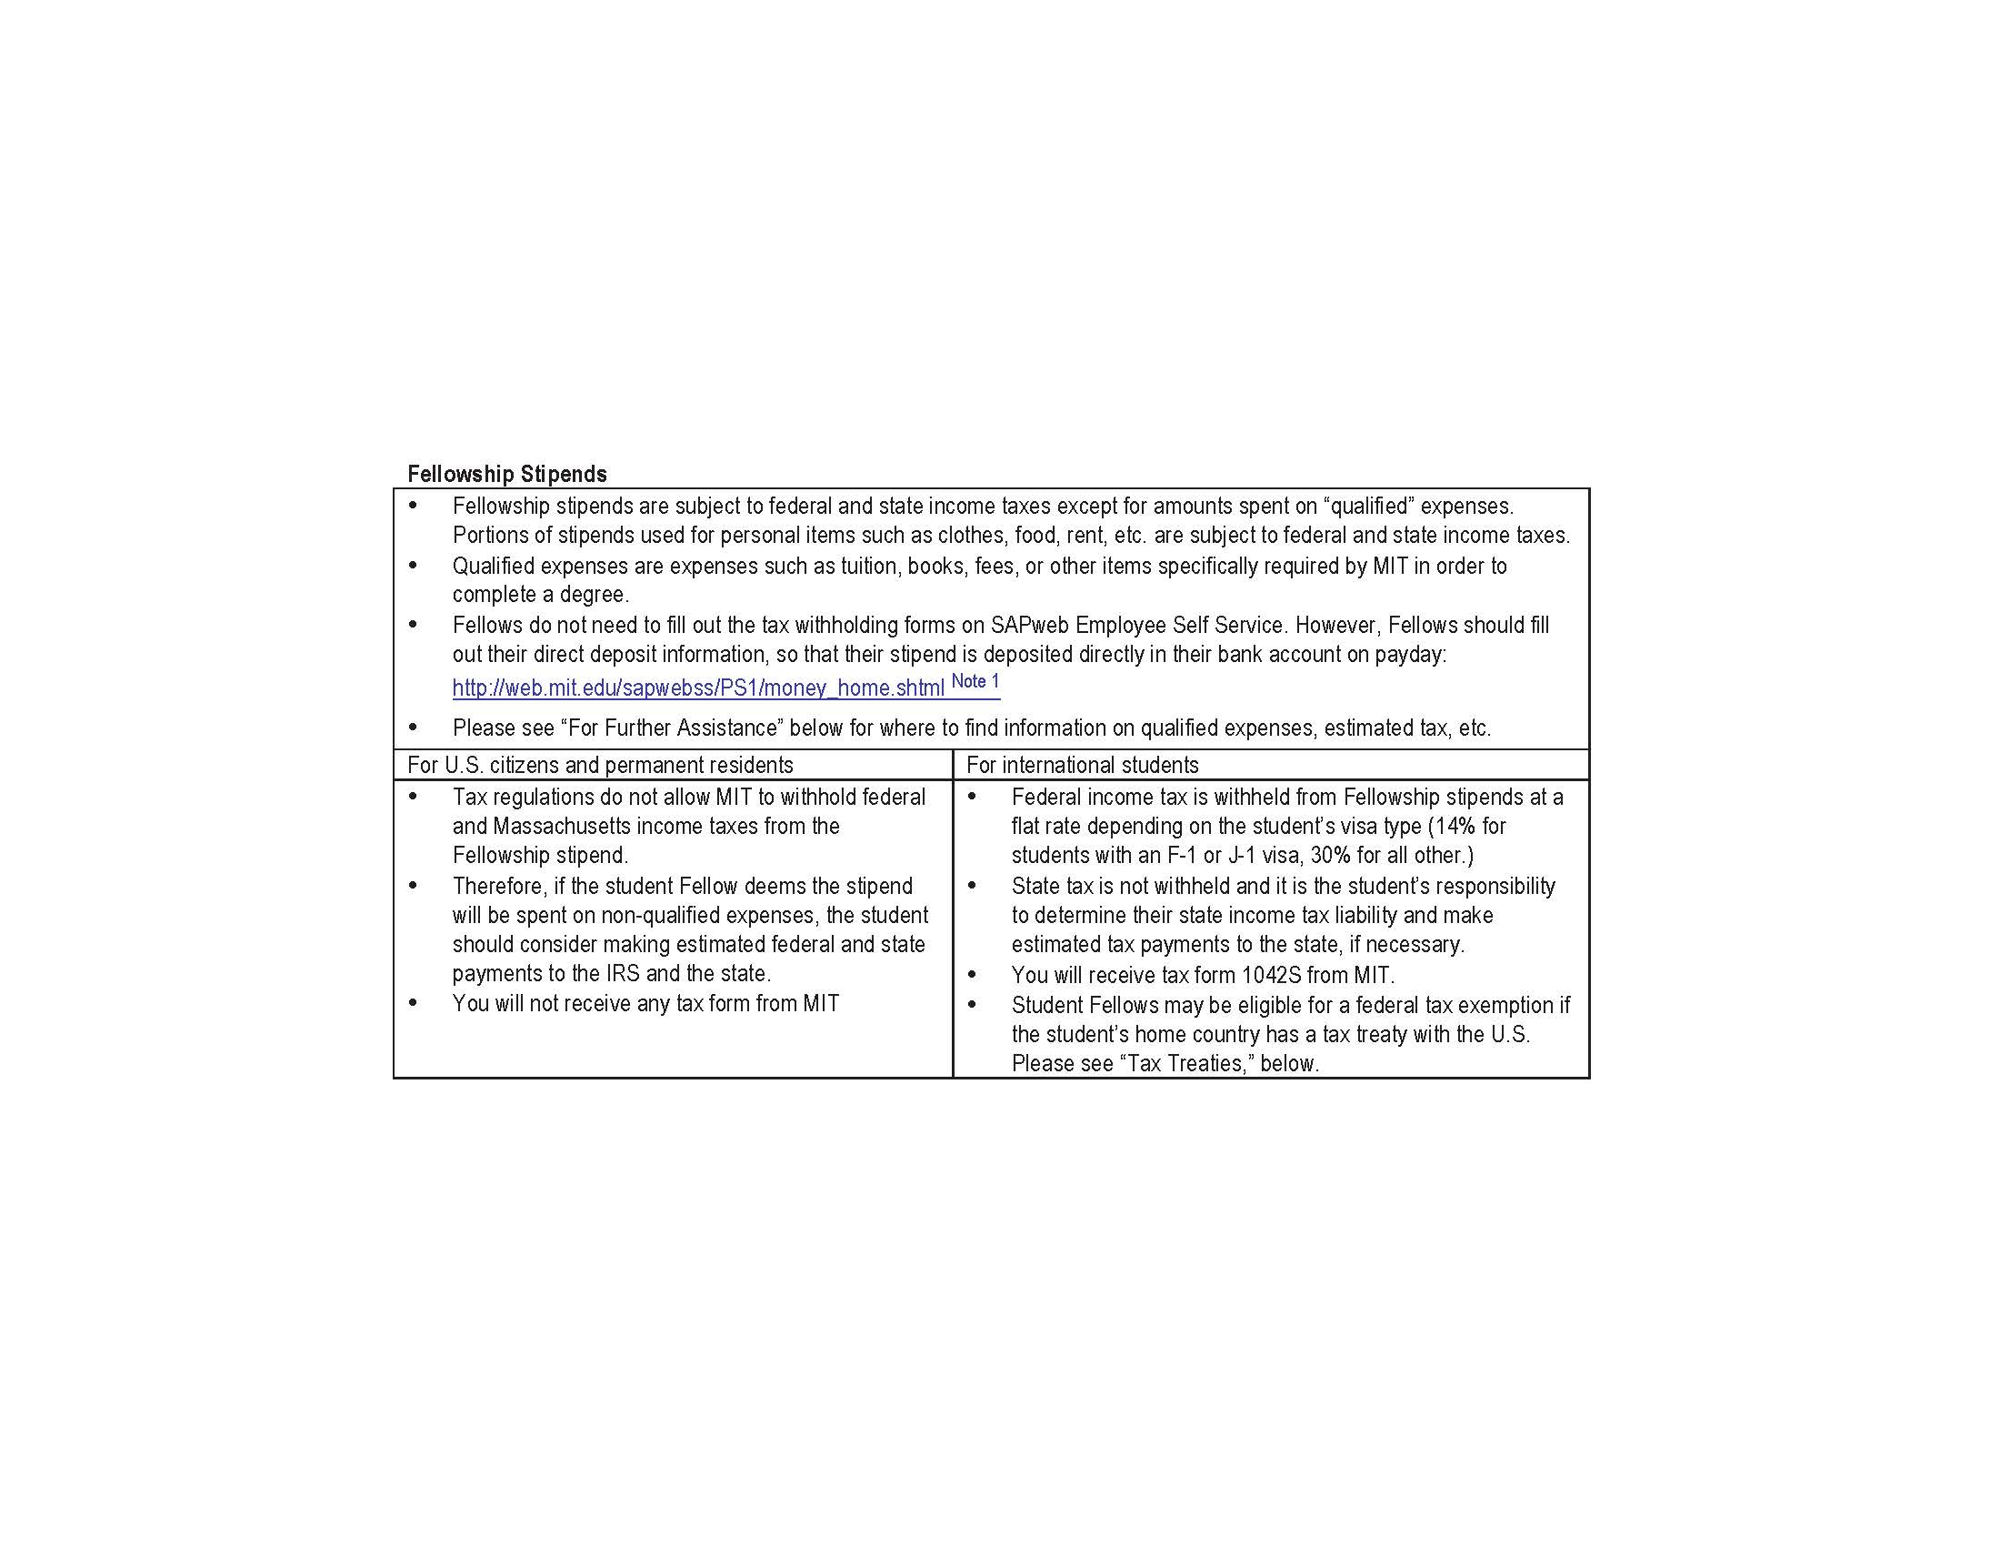

Slide 10
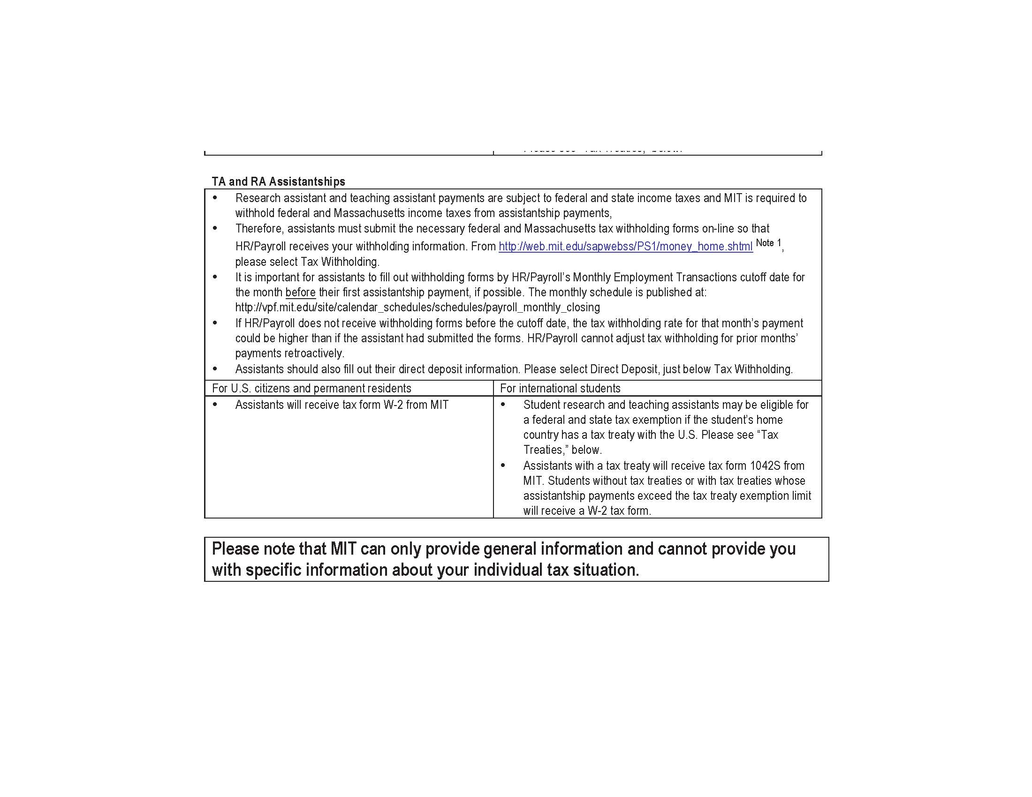

Slide 11
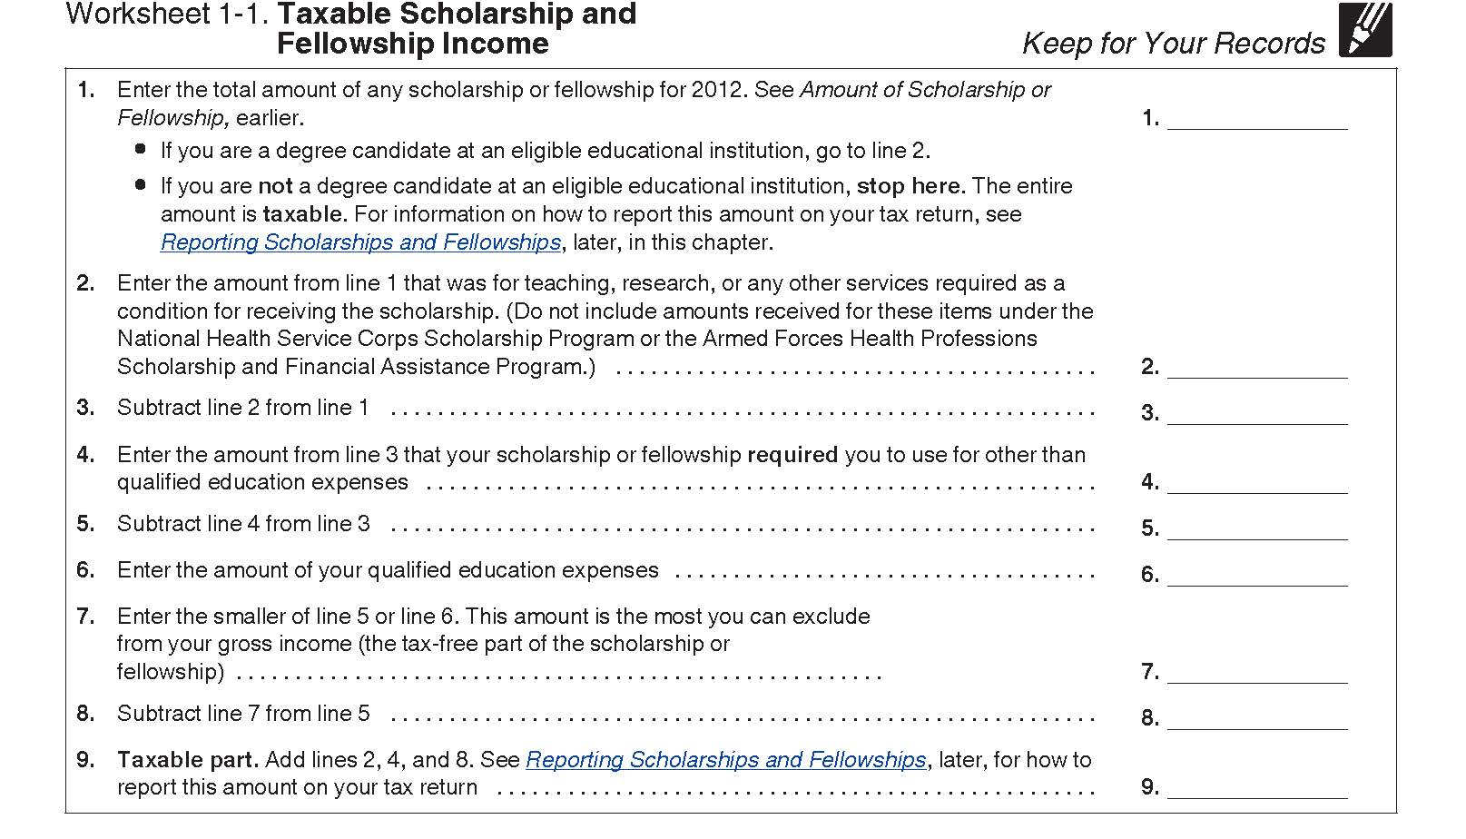

Slide 12
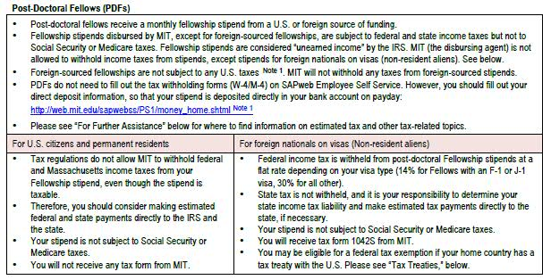

Slide 13
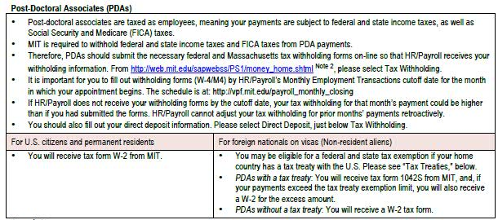

Slide 14
The Affordable Care Act (“ACA”)
This refers to the national health care law that started in 2014
Under the new law, each individual is required to have health insurance that has “essential coverage” to meet the individual mandate
If you are a resident for US income tax purposes, you must be covered by insurance that meets the essential coverage requirements or pay a penalty
For 2014, penalty is the greater of 1% of your yearly income or $95 per person
For 2015, penalty is 2% of your yearly income or $325 per person
MIT Health Plans meet the ACA requirements
Foreign health care coverage does NOT meet the ACA requirements

Slide 15
Massachusetts Tax Filings
Regardless of a taxpayer’s residency status for federal purposes, Massachusetts relies on its own law in determining whether or not a taxpayer is a resident, nonresident or part year resident
An individual is a full year resident if his or her legal residence is in MA (generally if you are living in MA with no intent to leave) or your legal residence is not in MA but you maintain a permanent place of abode in MA and you spend in aggregate more than 183 days in MA
A permanent place of abode generally means a dwelling place continually maintained by a person that is either owned or rented
Permanent place of abode does not generally include university provided housing or housing held temporarily for a particular documented purpose for which the stay does not exceed one year
An individual is a part year resident if you move to MA during the year and become a resident or you terminate your status as a MA resident by establishing a new residence outside the state
An individual is a nonresident if he or she is not a resident or inhabitant of MA as defined directly above

Slide 16
Massachusetts Tax Filings
If you are a resident for MA purposes (you have a permanent place of abode and you were present in MA for more than 183 days), you must report income and pay tax in MA on income tax Form 1 if your gross income exceeds $8,000
If you are a member of a MIT health insurance plan, you should have received Form MA 1099-HC (Individual Mandate Massachusetts Health Care Coverage) in the mail
You need information from the MA 1099-HC form to complete your MA tax return filing. Do not mail Form 1099-HC with your tax return. Keep it as proof you had insurance.

Slide 17
Tax Form List
Form 1040 US Individual Income Tax Return
Form 4868 Application for Automatic Extension of Time to File US Individual Income Tax Return
Form W-2 Wage and Tax Statement
MA Form 1 Massachusetts Resident Income Tax Return
MA Form 1-NR/PY Massachusetts Nonresident/Part Year Resident Tax Return
M-4868 Application for Automatic Extension of Time to File Massachusetts Income Tax Return (electronic filing generally required)

