Slide 1
MIT U.S. Income Tax Presentation International Scholars, Nonresidents for Tax Purposes
PwC Boston
Nabih Daaboul
Carol McNeil
Rich Wagman

Slide 2
Who are “Scholars”
Postdoctoral Associates and Fellows
Lecturers
Visiting Scientists, Scholars and Engineers
Visiting Professors
Others who have graduated and are now working at MIT J-1 H-1 F-1 on Practical Training TN O-1 B-1, etc.

Slide 3
Basic U.S. Tax Overview for International Scholars
A “foreign national” is a person born outside of the U.S.
For immigration purposes, a “Nonresident Alien” is a foreign national who is in the U.S. on a nonimmigrant visa
For tax purposes, a Nonresident Alien is a foreign national visa holder with specific tax filing requirements, tax withholding requirements and tax characteristics
If you were not present in the U.S. in 2014, then your first tax filings would begin for the tax year 2015 (Generally would file for 2015 tax year in 2016)

Slide 4
Federal and State Taxation
All individuals required to pay tax in the US will generally pay at both the federal and state level.
The term “Federal” refers to the US government. The Internal Revenue Service (“IRS”) administers the collection of federal taxes.
Taxpayers may also be required to pay tax at the state level. The collection of Massachusetts tax is administered by the Massachusetts Department of Revenue.

Slide 5
Foreign Source Income Exclusion
Salaries, fellowships and grants from the visitor’s country of residence or any other country outside the US are also not subject to tax in the US. This exclusion only applies to individuals who are nonresidents for tax purposes.

Slide 6
Federal Income Tax
All employee wages, independent contractor payments, fellowships, reimbursements, lodging, benefits or grants from a US source that a foreign visitor receives are generally taxable unless specifically exempt from tax by a U.S. law or treaty between the U.S. and a foreign country
Income tax treaties may provide for exemption from tax
If treaty applies at federal level, it should apply at the Massachusetts level as well

Slide 7
Federal Income Tax - Wages
Employee wages generally have income tax “withheld” (taken out by the employer) unless excluded from tax by a tax treaty between the US and the scholar’s country of residence.
The treaty exemption must be claimed on IRS Form 8233. Scholars should go to the payroll office with your passport, Visa and I-94, I-20 or DS-2019 and Form 8233 to see if a treaty applies.

Slide 8
Thomson Reuters Foreign National Tax Resource
https://web.mit.edu/scholars/mitonly/windstarliks.html
Tax related web site containing detailed information about Federal taxes, State taxes, residency for tax purposes, tax treaties, frequently asked questions and much more.

Slide 9
Fellowship Stipends
Fellowship stipends from a US source are taxable, unless exempt from a treaty
Nonresidents whose fellowships are administered by MIT will be sent Form 1042-S, usually in February (which is a summary of the total stipend)
Residents for tax purposes whose fellowships come from MIT will not be sent any summary
Postdoctoral fellowships are taxed at 14% (if on F-1 or J-1 visa) and 30% if in the US on another type of visa
MIT will not withhold taxes for Massachusetts purposes
For Massachusetts, consider estimated tax payments (paying taxes as income is earned – generally each quarter instead of paying at the end of the year). Quarterly payments are due on April 15, June 15, September 15 and January 15.

Slide 10
Independent Contractor Payments or Honoraria
Honoraria generally have income tax withheld at a flat rate of 30% unless excluded from tax by a tax treaty between the US and the scholar’s foreign country of residence. Form 1099 is sent at year end.
Massachusetts tax might not be withheld but income may still need to be reported. Refer to Massachusetts income tax slides at end of this presentation.

Slide 11
Travel Reimbursements
Travel reimbursements are generally not taxed as long as they are paid in accordance with an employer’s written reimbursement policy and travel receipts are submitted to the employer for reimbursement.
The travel must be required by the employer in order to be considered tax free.
Travel funds paid to nonemployees are reportable and often taxable.

Slide 12
U.S. Income Tax Treaties
Armenia, Australia, Austria, Azerbaijan, Bangladesh, Barbados, Belarus, Belgium, Bulgaria, Canada, China, Cyprus, Czech Republic, Denmark, Egypt, Estonia, Finland, France, Georgia, Germany, Greece, Hungary, Iceland, India, Indonesia, Ireland, Israel, Italy, Jamaica, Japan, Kazakhstan, South Korea, Kyrgyzstan, Latvia, Lithuania, Luxembourg, Malta, Mexico, Moldova, Morocco, Netherlands, New Zealand, Norway, Pakistan, Philippines, Poland, Portugal, Romania, Russia, Slovak Republic, Slovenia, South Africa, Spain, Sri Lanka, Sweden, Switzerland, Tajikistan, Thailand, Trinidad and Tobago, Tunisia, Turkey, Turkmenistan, Ukraine, United Kingdom, Uzbekistan, Venezuela
IRS Publications 515 and 901 detail the benefits available to nonresident aliens taking advantage of tax treaties

Slide 13
FICA Tax Social Security and Medicare
Employee wages paid by MIT are subject to the Social Security portion (6.2%) and the Medicare portion (1.45%). Both of these taxes are withheld from wages as they are paid. Special exemptions are available for FICA withholding as follows:
A social security agreement between the US and the Scholar’s country of residence could exclude wages from FICA
Services performed by visitors temporarily in the US on F-1, J-1 or M-1 visas are exempt as long as services are consistent with the purpose of the visa status and the visitor is classified as a nonresident
Wages are exempt from FICA if services are performed for a foreign government or an international organization
A person exempt from counting days under the Substantial Presence Test is exempt from FICA

Slide 14
Massachusetts State Income Tax
All employee wages that a scholar receives from MIT are generally considered income for state income tax purposes. In general, MIT will withhold state taxes in the same manner discussed above for Federal purposes.
If treaty applies at federal level, it should apply at the Massachusetts level as well.
Independent contractor payments/honoraria are considered taxable income for state purposes unless exempt from state tax by treaty.
US Source Fellowships: MIT will not withhold for Massachusetts taxes.
Consider estimated tax payments (paying taxes as income is earned – generally each quarter instead of paying at the end of the year). Quarterly payments are due on April 15, June 15, September 15 and January 15.

Slide 15
Exemptions from Withholding Tax
The following items of income are generally exempt from US or State income tax withholding
Foreign source income that comes from a payor outside the US to a nonresident alien
Tax treaty exclusions
Note – Treaties differ and should be discussed with the MIT payroll office
Reimbursements, such as employee travel and other.

Slide 16
Social Security Number or ITIN
IRS regulations require a nonresident alien to have either a social security number (“SSN”) or individual taxpayer identification number (“ITIN”) to claim income tax treaty benefits
NOTE – the process to receive either a SSN or ITIN is complex and can not be completed quickly. Planning well ahead before filing tax returns is essential.
Social security numbers can be obtained at the local Social Security Administration Office and are generally available to noncitizens authorized to work in the US
ITINs are available only if you do not qualify for a social security number

Slide 17
Who Needs an ITIN?
The IRS issues ITINs to foreign nationals and others who have federal tax reporting or filing requirements and do not qualify for SSNs.
A nonresident alien individual not eligible for a SSN who is required to file a US income tax return only to claim a refund of tax under the provisions of a US tax treaty needs an ITIN.
Other examples of individuals who need ITINs include:
A nonresident alien required to file a US income tax return
A US resident alien (based on days present in the US) filing a US income tax return
A dependent or spouse of a resident alien
A dependent or spouse of a nonresident alien visa holder

Slide 18
How to Apply for an ITIN
To obtain an ITIN, you must complete IRS Form W-7, IRS Application for Individual Taxpayer Identification Number
Most often, you will request an ITIN as part of filing your US income tax return
You attach the Form W-7 to the front page of your valid federal income tax return
You must include proof of identity document(s) with your application
If you choose to send in your original passport with your application, no other documents are required
If you wish to send copies of documents as long as they are either certified by the issuing agency or you have them certified at a US Embassy or Consulate office (it is highly recommended you call in advance to insure these services can be performed)
If you are using certified copies of documents to prove your foreign status or identity, two of the following documents must be included (at least one must include a photograph – note, a photograph is not required for a dependent under the age of 14 or the age of 18 if a student):
US Citizenship and Immigration Services (USCIS) photo identification
Visa issued by US Department of State
US driver’s license
US military identification card
Foreign diver’s license
Foreign military identification card
National identification card
US state identification card
Foreign voter’s registration card
Civil birth certificate*
Medical records (valid only for dependents under age 6)*
School records (valid only for dependents under age 14 or 18 if a student)* *Can be used only if foreign documents

Slide 19
How to Apply for an ITIN (cont.)
Where to apply
By mail. Mail Form W-7, your tax return and identifying documents to Internal Revenue Service ITIN Operation P.O. Box 149342 Austin, TX 78714-9342
In person. Bring your completed forms and documentation to any IRS Taxpayer Assistance Center in the US or IRS office abroad. See IRS.gov for a list of designated centers that are available for assistance in completing applications.
Through an acceptance agent. You can also apply through an Acceptance Agent authorized by the IRS. To get a list of agents, visit IRS.gov and enter “acceptance agent program” in the search box at the top of the page.

Slide 20
U.S. Nonresident Alien Income Tax Return
A nonresident alien with US source income (including wages, fellowships, stipends) sends a Nonresident Alien tax return, Form 1040NR or Form 1040NR-EZ, to the Internal Revenue Service (“IRS”).
All nonresident aliens, including family members, must file Form 8843
MIT will report earnings paid to nonresident aliens on Form W-2 and/or Form 1042-S
The U.S and Massachusetts utilize the calendar year for income tax purposes (January 1 - December 31)

Slide 21
Payment Summaries
Form W-2: Salary and wage payments to employees and students not including wages that are exempt under a tax treaty.
Form 1042-S: Stipend/fellowship payments to employee and student foreign nationals covered by a tax treaty or fellowship payments to employee and student foreign nationals which had federal income tax withheld.

Slide 22
When and Where to File
Nonresident aliens who were physically present in the U.S. during any part of a calendar year should file all tax returns by April 15th of the following year
If you need more time to file your tax return, you may request an extension by filing Form 4868 to receive a six month extension of time to file to October 15th.
NOTE an extension of time to file does not extend the time to pay any taxes due. You must pay any taxes due at the time you file an extension request.
All nonresident returns are mailed to *: Department of Treasury Internal Revenue Service Center Austin, TX 73301-0215
* Unless being filed with a W-7 ITIN application enclosed (see slide 19)

Slide 23
Form 8843 Statement for Exempt Individuals and Individuals with a Medical Condition
Form 8843 provides information about your Visa, residency, length of time in the U.S., study program, etc. and is the way you alert the IRS to your nonresident status in the U.S.
It must be filed by all nonresident aliens in F or J status.
The Form 8843 must be filed each year with the Form 1040NR, 1040NR-EZ or by itself if a 1040NR is not required
Due date for 1040NR and 1040NR-EZ is April 15th
If you have no US source income, you should file Form 8843 only, no later than June 15th
A separate Form 8843 should be filed for your spouse and dependent children each year

Slide 24
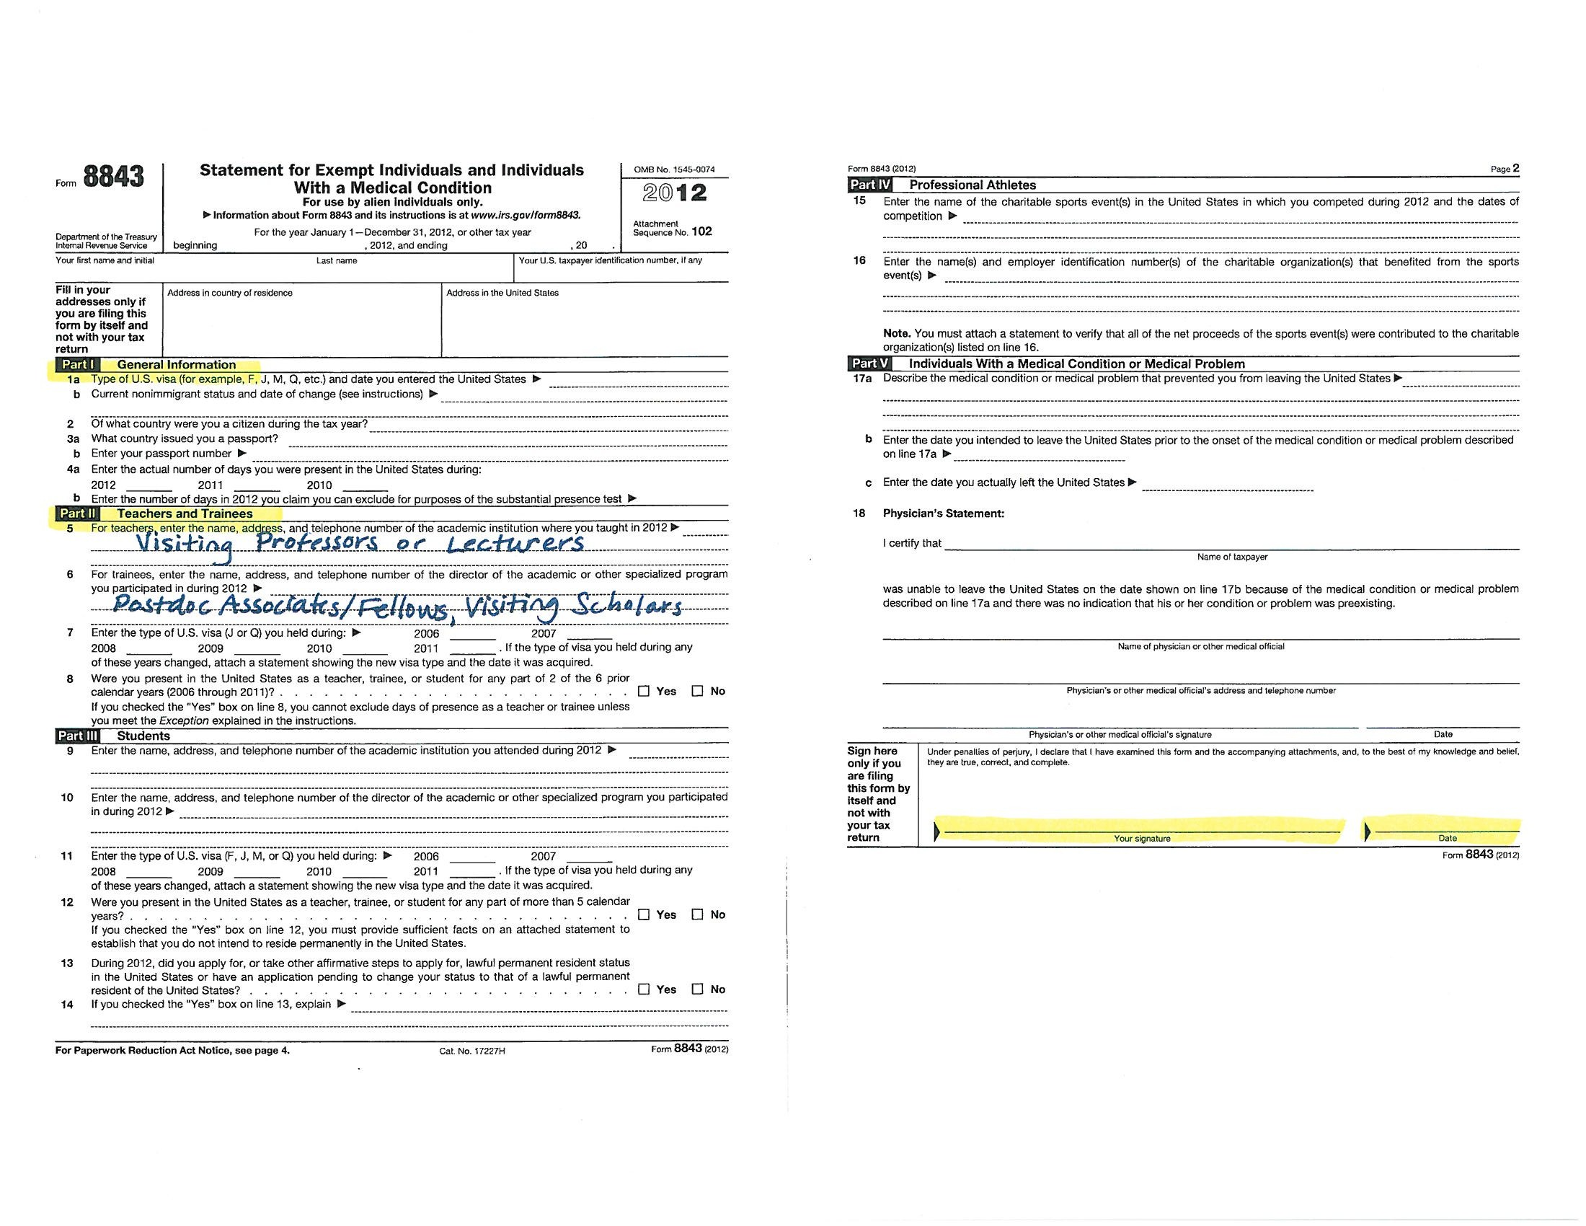

Slide 25
Residency Determination for U.S. Tax Purposes
A resident for U.S. tax purposes is a non U.S. citizen who meets either the “green card” test or “substantial presence” test
J non-student visa holders (researchers, scholars, teachers, etc.) are generally considered residents after their first 2 years of presence(including partial years) in the U.S. For example, if you came to the US on December 20, 2014, 2014 would be your first year of presence in the US, and 2015 would be the second.
If you have prior visa history, the two years starts with your previous time in the US which must be taken into account in determining the 2 year rule
H and other visa holders are considered residents for tax purposes when they meet the substantial presence test

Slide 26
Substantial Presence Test
In the U.S. for at least 31 days during 2014, and
183 days during the three year period that includes the current year and the two preceding calendar years under the following formula
All days in the U.S. during the current year (2014)
1/3 of the days present in the U.S. in the first preceding year (2013)
1/6 of the days present in the U.S. in the first second preceding year (2012)
Refer to IRS Publication 519 or use the MIT provided software for assistance in determining your residency status

Slide 27
The Affordable Care Act (“ACA”)
This refers to the national health care law that started in 2014
Under the new law, each individual is required to have health insurance that has “essential coverage” to meet the individual mandate
International students on F or J visas are exempt from the mandate to purchase ACA qualifying coverage for their first 5 years in the US
If you are a resident for US income tax purposes, you must be covered by insurance that meets the essential coverage requirements or pay a penalty
For 2014, penalty is the greater of 1% of your yearly income or $95 per person
For 2015, penalty is 2% of your yearly income or $325 per person
MIT Health Plans meet the ACA requirements
Foreign health care coverage does NOT meet the ACA requirements

Slide 28
Massachusetts Tax Filings
Regardless of a taxpayer’s residency status for federal purposes, Massachusetts relies on its own law in determining whether or not a taxpayer is a resident, nonresident or part year resident
An individual is a full year resident if his or her legal residence is in MA (generally if you are living in MA with no intent to leave) or your legal residence is not in MA but you maintain a permanent place of abode in MA and you spend in aggregate more than 183 days in MA
A permanent place of abode generally means a dwelling place continually maintained by a person that is either owned or rented
Permanent place of abode does not generally include university provided housing or housing held temporarily for a particular documented purpose for which the stay does not exceed one year
An individual is a part year resident if you move to MA during the year and become a resident or you terminate your status as a MA resident by establishing a new residence outside the state
An individual is a nonresident if he or she is not a resident or inhabitant of MA as defined directly above

Slide 29
Massachusetts Tax Filings
If you are a resident for MA purposes (you have a permanent place of abode and you were present in MA for more than 183 days), you must report income and pay tax in MA on income tax Form 1 if your gross income exceeds $8,000
If you are not a resident in MA and you have MA source income or you earned more than $8,000 and the income is not exempt from taxation under a treaty, you should file Massachusetts Form 1-NR to report the income and pay the applicable tax
If you are a member of a MIT health insurance plan, you should have received Form MA 1099-HC (Individual Mandate Massachusetts Health Care Coverage) in the mail
You need information from the MA 1099-HC form to complete your MA tax return filing. Do not mail Form 1099-HC with your tax return. Keep it as proof you had insurance.

Slide 30
Tax Form List
Form 1040 US Individual Income Tax Return
Form 1040NR US Nonresident Alien Income Tax Return
Form 4868 Application for Automatic Extension of Time to File US Individual Income Tax Return
Form 8843 Statement for Exempt Individuals and Individuals with a Medical Condition
Form 8233 Exemption From Withholding on Compensation for Independent (and Certain Dependent) Personal Services of a Nonresident Alien
Form 1042-S Foreign Person’s US Source Income Subject to Withholding
Form W-2 Wage and Tax Statement
Form W-7 Application for IRS Individual Taxpayer Identification Number
MA Form 1 Massachusetts Resident Income Tax Return
MA Form 1-NR/PY Massachusetts Nonresident/Part Year Resident Tax Return
M-4868 Application for Automatic Extension of Time to File Massachusetts Income Tax Return (electronic filing generally required)

